Slide 1
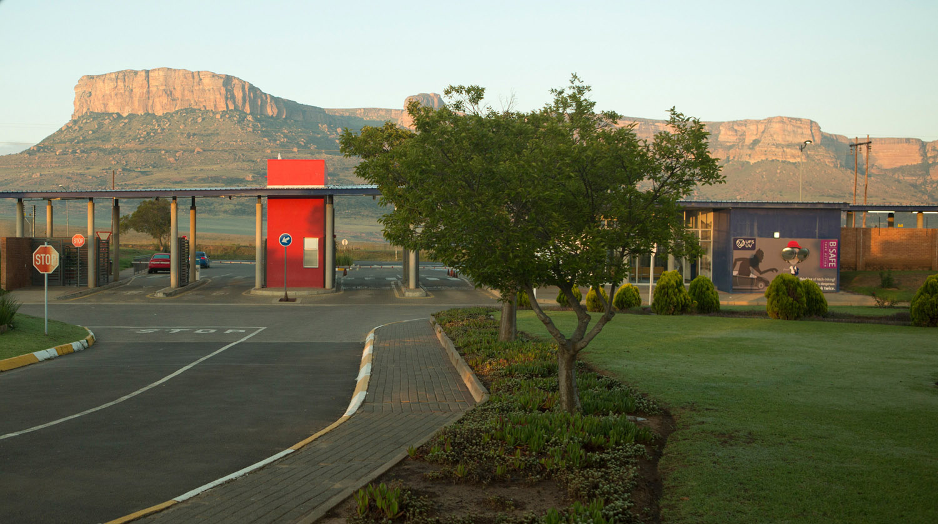
Heatwaves and heat stress a South African perspective
T: +27 51 401 9111 | E: info@ufs.ac.za | www.ufs.ac.za

Slide 2
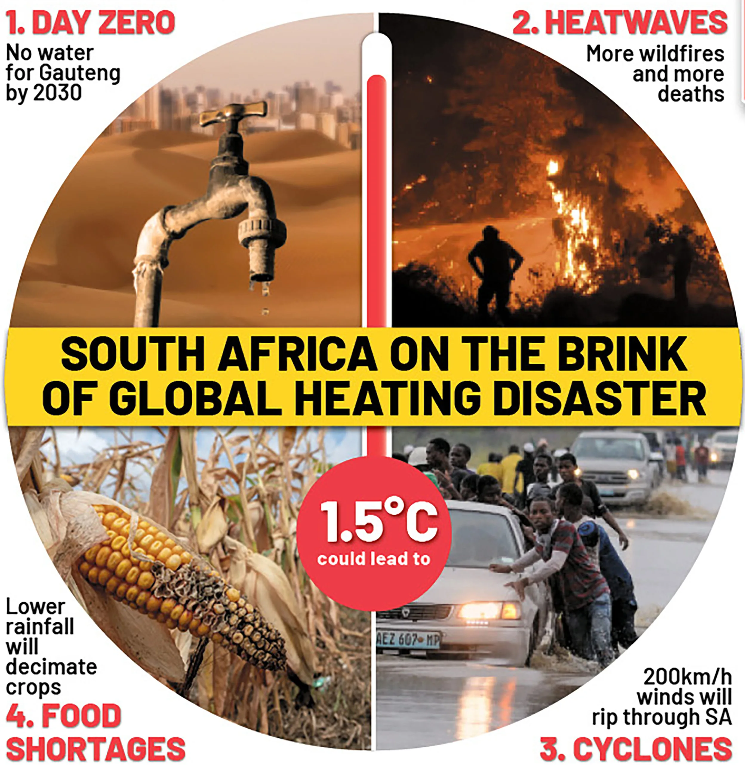

Slide 3
Introduction
Notes:
Climate is unique in South Africa
Low lying areas
Escarpment
Sea Currents warm cold
Modes of variability

Slide 4
South Africa’s people
60,14 million people
Life expectancy 59,3 years for males, and 64,6 for females
Period 2016-2021, Gauteng and Western Cape are estimated to experience the largest infor of migrants of +- 1.5 million
28,3% are younger than 15 years (17,04 million)
9,2% is 60 years or older (5,51 million) – increasing over time

Slide 5
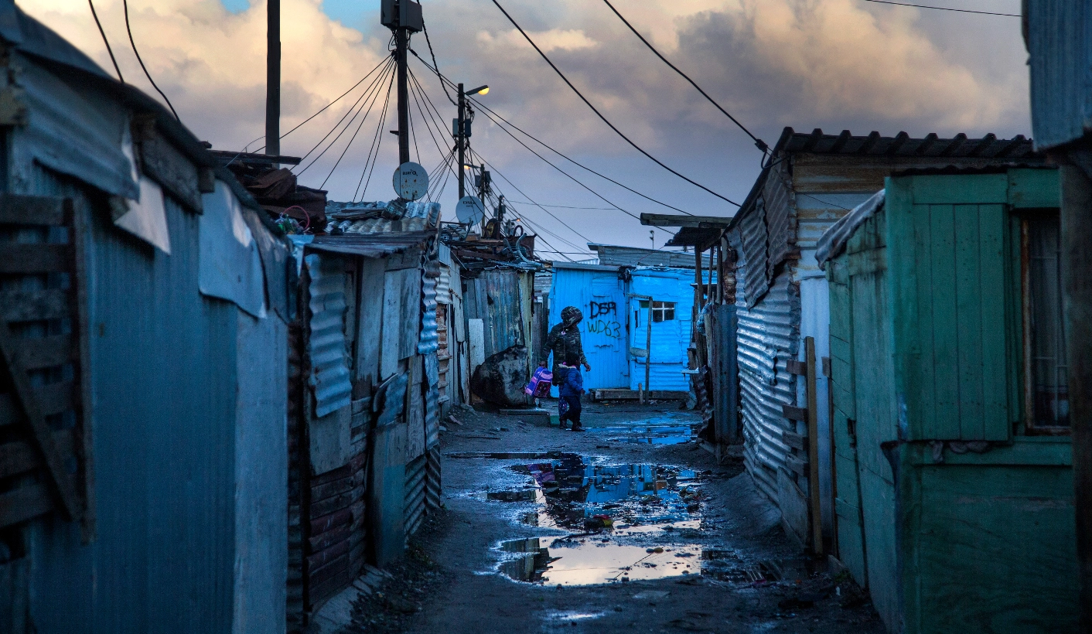
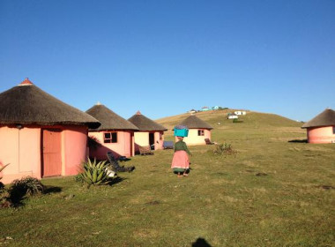
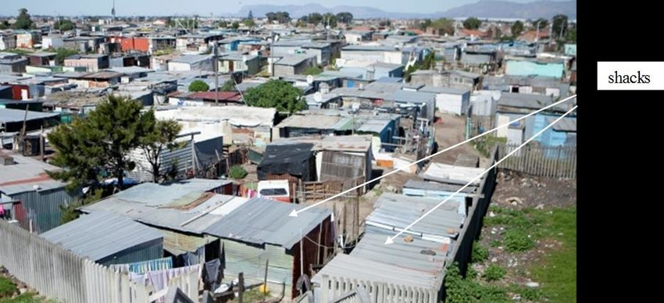
South Africa’s people
81,9% of all households reside in formal dwellings
Government subsidy to access housing has increased from 5.6% in 2002 to 13,7% by 2019.
12,7% of households still live in informal dwellings
5,1% in traditional dwellings (rural areas)
Notes:
Stats SA General Household survey of 2019

Slide 6
Heatwaves
Definitions
South African Weather Service – weather stations
“when for at least three consecutive days the maximum temperature of a certain region or grid point is five degrees or higher than the average mean maximum for the hottest month for that particular station or grid point”

Slide 7
Heatwaves
Past 3 decades - 91 weather-related disasters reported
1,792 casualties, 2,409 injuries, left 58,000 people homeless and affected an estimated 2 million people
Of these only three severe ETEs were reported/recorded
6 July 1996 Cold wave
21 May 2007 Cold snap
1 January 2016 Heatwave
Notes:
On 6 July 1996, a cold wave in KwaZulu-Natal Province resulted in 30 casualties. Gauteng and the Eastern Cape Province experienced a cold snap on 21 May 2007, which lasted for two days and led
to 22 casualties.
The only heatwave recorded in this database occurred in North-West Province on 1 January 2016 which lasted for 10 days and resulted in 11 fatalities and 20
injuries (EM-DAT CRED, 2020).
However, due to poor health surveillance, the impacts of ETEs are considered under-reported in many developing countries, including South
Africa (Ngwenya et al., 2018; Scovronick et al., 2018).
South Africa has already seen considerable temperature increases since the 1960s, when average temperatures have increased by 1.5℃, with more marked increases across arid, inland areas of the country.
Both maximum and minimum daily temperatures have risen, across all seasons.
Temperature extremes have also increased significantly. Notably, the rate of temperature change has fluctuated, with the highest rates of increase identified during the mid 1970s to early 1980s, with highest rates again observed in the late 1990s to mid 2000s.

Slide 8
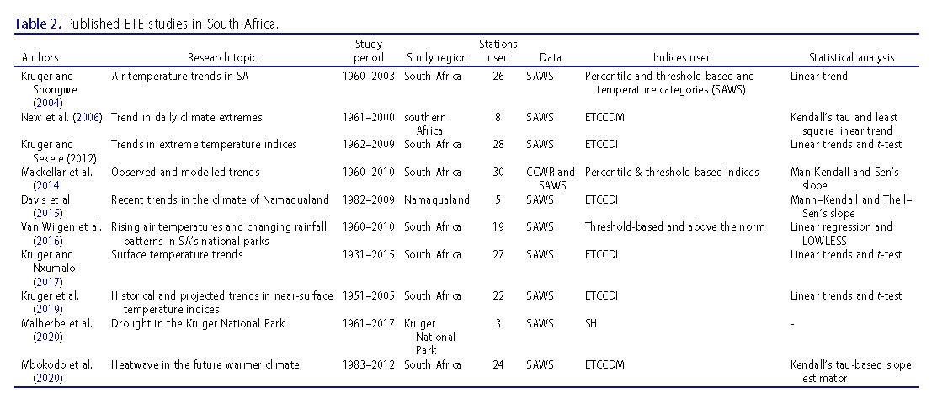
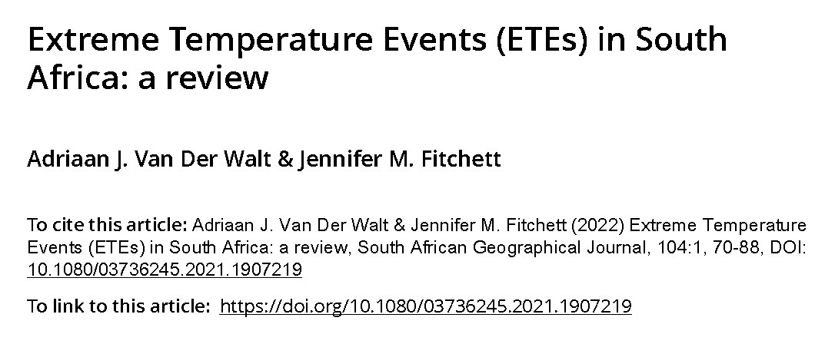
Heatwaves
Only a limited number of studies focus on Extreme Temperature events

Slide 9
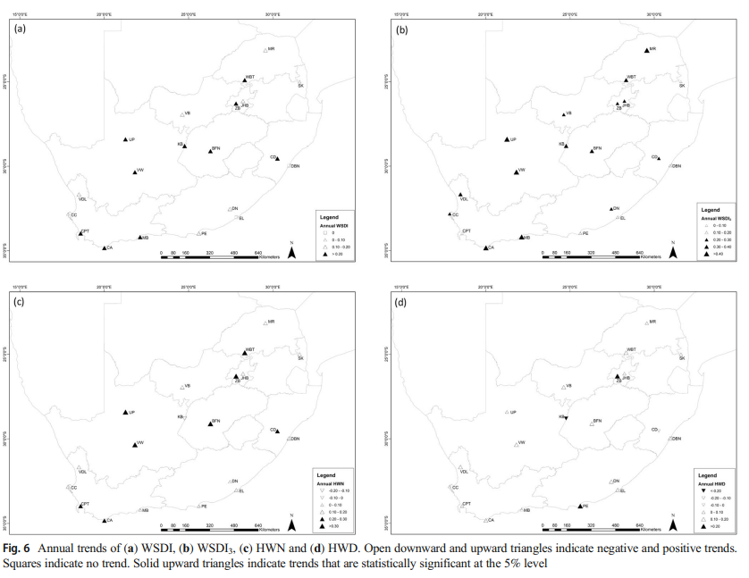
WMO ETCCDI
WMO ET-SCI
Notes:
Trend results based on the World Meteorological Organization Expert Team on Climate Change Detection (ETCCDI) and the World Meteorological Organization Commission for Climatology and Indices Expert Team on Sector-Specific Climate Indices (ET-SCI)

Slide 10
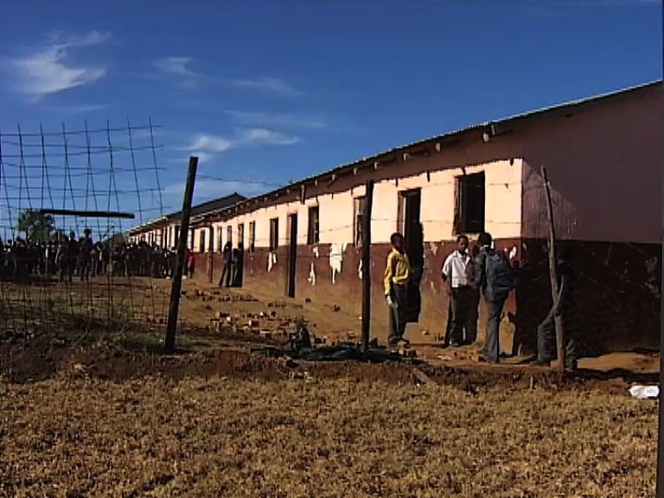
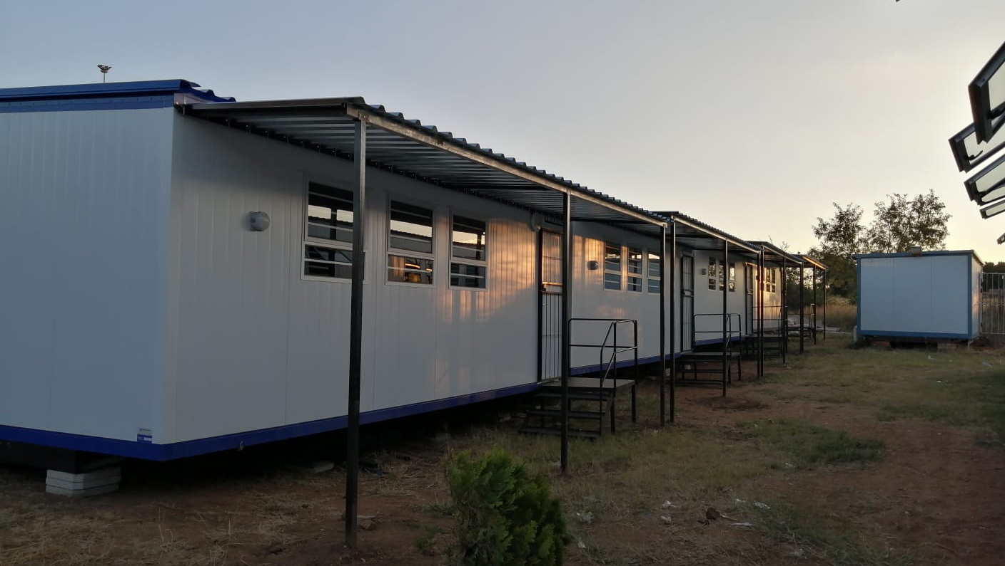
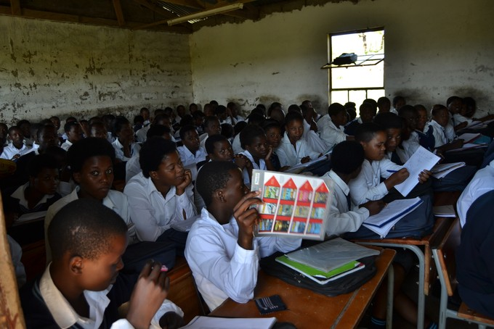
Heat Stress or Cold Stress in SA?!
Heat Stress – SA
Infrastructures
Pressure on energy demand
Outdoor and indoor workers and activities
Influence young and old
Notes:
Indoor thermal Comfort
Outdoor thermal Comfort - indices

Slide 11
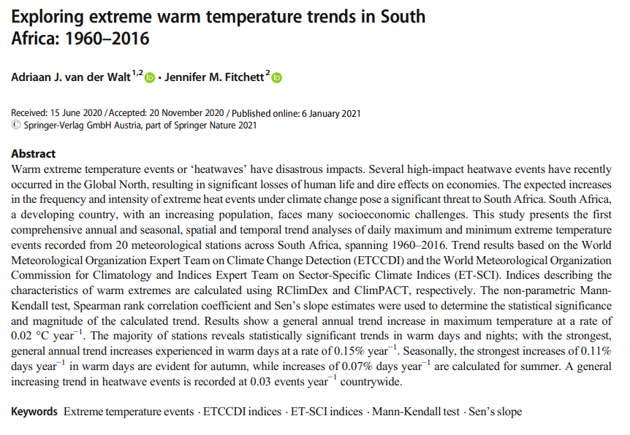
Notes:
Different Indices

Slide 12
Notes:
Different Indices

Slide 14
Policies, Mitigation and Adaption
The Department of Environment, Forestry and Fisheries
Climate Change Bill – published on 11 October 2021
“To enable the development of an effective climate change response and a long-term, just transition to a low-carbon and climate-resilient economy and society for South Africa in the context of sustainable development; and to provide for matters connected therewith”
“anthropogenic climate change represents an urgent threat to human societies and the planet and requires an effective, progressive and incremental response;”
“climate variability in the Republic, including the increased frequency and intensity of extreme weather events, will affect, amongst other things, human health, access to food and water, biodiversity, habitats and ecosystems, the coast and coastal infrastructure and human settlements;”
Notes:
The bill places a legal obligation on every organ of state to coordinate and harmonise their various policies, plans, programmes, decisions and decision-making processes relating to climate change.
This is to ensure that the risks of climate change impacts and associated vulnerabilities are taken into consideration and give effect to the principles and objectives set out in the envisaged Act.
Local officials – including mayors – will be required to undertake a climate change needs and response assessment within one year of the publication of the National Adaptation Strategy and Plan.
The bill further requires a climate change response implementation plan to be developed within two years of undertaking the climate change needs and response assessment.
It further requires a climate change response plan to be integrated into a province, district or municipality’s development plan.

Slide 15
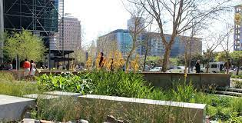
Targets and Scenario - planning
The bill provides for the establishment of ‘adaptation objectives’ in South Africa. These are aimed at establishing specific green targets that the country should hit and the associated timeframes.
The minister of the environment is also required to develop ‘adaptation scenarios’ which anticipate the likely impacts of climate change in the country over the short, medium and longer-term.
The scenarios must be developed within one year of the envisaged Act coming into operation.
Notes:
Muncipalities are already
Planting more trees

Slide 16
Thank you

